Slide 1

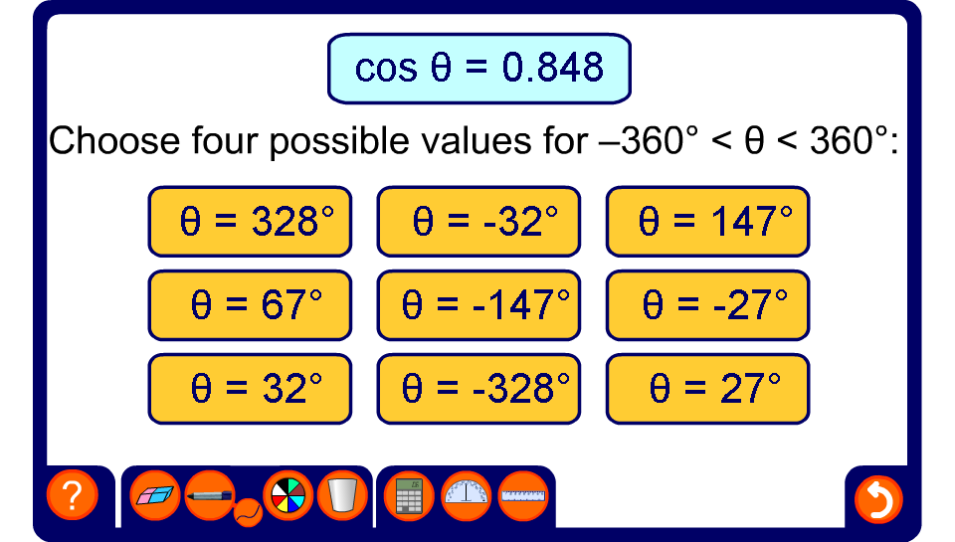


Solving equations in θ
Notes:
Pupils can use their calculators to find a value for θ between 0° and 90°.
Pupils should then be encouraged to recall in which quadrant the given ratio is positive (or negative). They can then use a sketch of the four quadrants to find the other three solutions in the given range.
These equations can also be solved using sine, cosine or tangent graphs.

